Slide 1
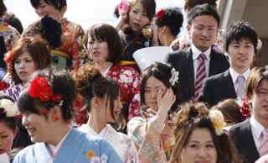
Promoting Citizenship through Language Education: What Role for Japanese Teachers of English?
平和教育京都国際フォーラム
Ian Hosack Ritsumeikan University
hosack@ss.ritsumei.ac.jp

Slide 2
Citizenship education
Citizenship education in schools is about preparing young people for effective participation in public life – as citizens
Current interest in citizenship education
technological change; globalization; environmental problems etc.
sense of crisis (disengagement from public life, moral decline etc.)
Connections with other ‘educations’
Civics Political Education Environmental Education
Development Education Peace Education Anti-Racist Education
Human Rights Education World Studies Global Education

Slide 3
Citizenship (Osler & Starkey, 2005a)
Status
who is recognized as a citizen under law?
citizenship as exclusion (‘us’ and ‘them’)
Feeling
feeling of belonging to a community
attitudes towards oneself and relations with others
Practice
getting things done in the community
exercising rights, by oneself and in collaboration with others

Slide 4
Citizenship Education: National Curriculum for England
Citizenship a required subject
since 2002 (ages 11–16)
Based on the Crick Report (QCA, 1998)
Key concepts
- democracy & justice
- rights and responsibilities
- identities and diversity

Slide 5
National Curriculum for England
3 key processes:
Critical thinking & enquiry
reflecting on different opinions & beliefs; exploring controversial issues ;
researching issues using range of sources; evaluating sources – identifying bias etc.
Advocacy & representation
experience of discussions, debates, voting; forming, expressing & justifying opinions;
representing the views of others.
Taking informed and responsible action
work individually & with others to take action on citizenship issues

Slide 6
Citizenship education in Japan
“formal curriculum”
comes under social studies umbrella
‘koumin’ course includes study of modern society, economics, political system, ethics
“informal curriculum”
school life highly participatory
students have many responsibilities
nurtures ‘community’ values

Slide 7
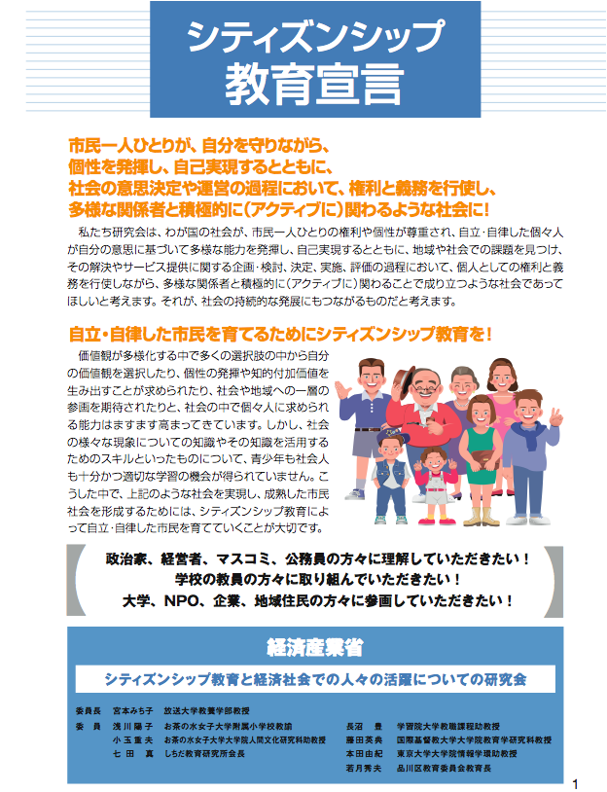
Citizenship education in Japan
METI: Declaration on Citizenship Education (2006)
Concerns re. changing society – rising inequality, increasing diversity, changing personal values etc.

Slide 8
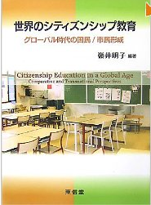
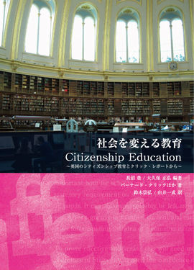
Citizenship Education in Japan

Slide 9
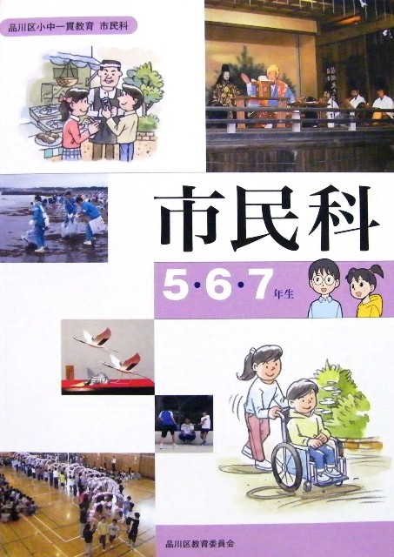
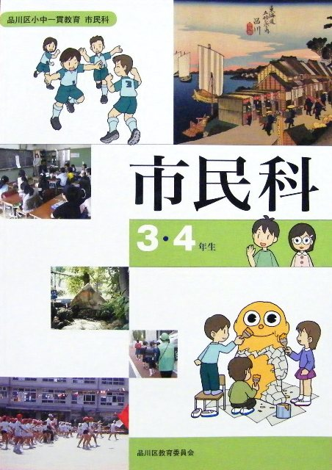
Citizenship education in Japan
Experiments with citizenship education in Japan
exhibit a range of thinking
Mizuyama (2010) – lack of consensus
e.g. personal morality (Shinagawa),
political literacy (Ochanomizu)

Slide 10
Citizenship education in Japan
Karaki (2007) - tension between
traditional notions of citizenship
strong national identity, loyalty to state,
newer, ‘post-national’ ideas
local involvement in civil society, global
responsibilities
国民
市民

Slide 11
Citizenship education in Japan
“there is a marked struggle for the particular form of citizenship education that will eventually emerge”
(Davies, Mizuyama & Hampden-Thompson, 2010, p.175)
Do Japanese English teachers have a role to play?

Slide 12
Linking foreign language teaching & citizenship education
Council of Europe
language teaching & citizenship education have similar aims
“both are concerned with intercultural interaction and communication, the promotion of mutual understanding and the development of individual responsibility”
(Beacco & Byram, 2003, cited in Starkey, 2005, p. 28)

Slide 13
Foreign language teachers can...
1. Teach for intercultural citizenship
Promote tolerance, respect for diversity & intercultural competence, a critical perspective on one’s own culture
Byram (2003) - The main task of foreign language teachers is,
“to introduce young people to experience of other ways of thinking, valuing and behaving.” (p.127)
Especially important for increasingly multicultural Japan
(Tsuneyoshi, 2011)

Slide 14
Foreign language teachers can...
2. Teach for dialogue
- Communicative Language Teaching
promotes ability to engage in dialogue – to express ideas,
listen and respond to others, reach agreements etc.
“In many respects communicative methodology is in itself
democratic. The skills developed in language classes are
thus directly transferable to citizenship education.”
(Starkey, 2005, p. 32)

Slide 15
Foreign language teachers can...
3. Teach Citizenship-related Content
- focus on important social & political topics, global issues
- encourage reflection on key concepts – democracy,
justice, equality, rights etc.
- Content-Based Language teaching

Slide 16
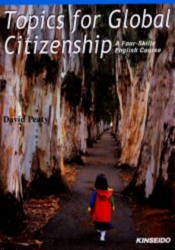
Content-based English textbooks being used in Japanese universities

Slide 17
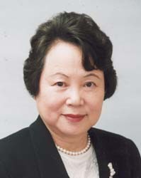
English in Japan – a national priority
e.g. Action Plan to Cultivate Japanese with
English Speaking Abilities, 2003
“For children living in the 21st century, it is essential for them to acquire communication abilities in English as a common international language. …English abilities are important in terms of linking our country with the rest of the world, obtaining the world’s understanding and trust, enhancing our international presence and further developing our nation.”
Toyama Atsuko, Minister of Education, 2003

Slide 18
Research Questions
RQ 1
What role, if any, do Japanese teachers of English (JTEs) see for themselves in teaching for citizenship?
Subquestions: i) What do JTEs understand by “good citizenship”?
ii) What links, if any, do they see between citizenship education and foreign language education?

Slide 19
Research Questions
RQ 2
How are some JTEs combining citizenship teaching objectives with language teaching?
Subquestions: i) What citizenship teaching objectives do they have?
ii) What resources are they using to
achieve those objectives?
iii) What pedagogical practices are they
adopting?

Slide 20
Questionnaire
Conducted in Japan Nov 2011 ~ March 2012
- A Purposive Sample – teachers who’d shown an interest in citizenship teaching (not typical?)
Section I What do Japanese English teachers
understand by “good citizenship”?
30 citizen attributes (values, skills)
how important to Japanese citizenship?
5-pt scale
Completely unnecessary Õ Essential
Attributes cover range of perspectives on citizenship (national, global etc.)

Slide 21
Section I: Requirements of Japanese Citizenship

Slide 22
Questionnaire
Section II What links do teachers see between citizenship education and English teaching?
- 25 citizen teaching objectives (skills / values)
Teachers consider how far each can be furthered in English classes
5-pt scale
Not at all Õ To a very great extent

Slide 23
Section II: Citizenship Teaching through English Classes?

Slide 24
Results
46 completed questionnaires
included JHS/SHS teachers
public & private schools
- An experienced sample
44% 40-49 yrs 41% 50+ yrs
75% teaching more than 16 yrs

Slide 25
Results
84% - said Japanese English teachers do have a role to play in teaching for citizenship
80% - thought they personally had a role to play
Purposive sampling on target?

Slide 26
What skills/values are most important for Japanese citizenship?
Top 4 citizen attributes
- Respect for human rights
- Commitment to democratic values
- Voting
- Showing respect / tolerance for other cultures
Bottom 3
- Wish to promote Japan’s interests in the world
- Patriotism
- Willingness to obey those in authority

Slide 27
What skills/values are most important for Japanese citizenship?
Consensus on global dimension of citizenship
⅓ – global citizenship more important than national citizenship
¼ - global responsibilities consistent with strong national citizenship

Slide 28
What skills/values can be promoted through English lessons?
Teachers see greatest potential for promoting following citizenship objectives through English:
95% tolerance & respect for diversity
95% intercultural competence
respect for human rights
87% critical thinking
85% responsibility as global citizen

Slide 29
Semi-structured interviews
Continued with purposive sampling
- Identified “engaged” teachers from survey responses

Slide 30
Interview findings
Teaching for dialogue?
Some evidence, but communicative activities appear quite rare.
Typically part of Integrated Studies period
or when ‘team teaching’ with ALT
Sakui (2004), Aspinall (2013) – Communicative approach weak in Japanese schools

Slide 31
Interview findings
Teaching for intercultural citizenship?
Most teachers: teaching for tolerance / openness to other cultures their prime objective
- Common view that the struggle to learn English is important here
English itself is something different from our usual life…First, it’s a thing we can’t understand…so we are forced to accept something new. … First, we couldn’t understand it, but by learning, little by little we begin to understand it. … I think it’s a great pleasure for students. So, I think English is a first step for the students to ‘co-live’ with others from different backgrounds in harmony.
Senior High School Teacher, Kumamoto Pref.

Slide 32
Interview findings
Teaching for intercultural citizenship?
Team teaching - some opportunities for intercultural exchange with ALTs
But for most teachers – “teaching about culture”
focuses on content
In the class, we can use a lot of materials, we can use a lot of topics that deal with, for instance, different cultures or different ways of living. So that’s why Japanese teachers of English are in a better position [than teachers of other subjects] to teach those students about differences.
Private Senior High School Teacher, Kyoto

Slide 33
Interview findings
Working with citizenship-related content
Survey – 61% teachers agreed textbook content facilitating teaching about culture and other aspects of citizenship
Editors have begun to include very interesting topics nowadays, so almost in any textbook human rights issues have been dealt with, and environment and international education, and also Japanese culture…And in textbooks of 20 years ago or so, … English-speaking countries were shown – America, England, Canada. But nowadays, some people we don’t know are shown. So that’s a better kind of global education.
(Private High School Teacher, Kyoto)

Slide 34
Interview findings
Some critical views of textbook content
Important to supplement textbooks
- develop topics in a more meaningful way
English textbooks mainly introduce sports, science, someone’s diary, novels, or some foreign countries’ culture…Very superficial…for example, … what they eat, or what kind of festivals, and so on. Actually those are introducing different cultures. But we can’t say it’s citizenship education … The topics are not aimed at raising thinking skills or critical thinking, or raising global awareness. For example, [by encouraging them to] reflect on their values, reflect on their lifestyles.
Public High School Teacher, Miyagi Pref.

Slide 35
Supplementary materials : Two Views
Do you supplement the textbook?
Yeah, I sometimes do that, but …because of the pressure for us to have our students pass the entrance examination, we have little time to do extra materials, to focus on global education and citizenship education…
(Private High School Teacher, Tokyo)
I always think it’s really up to the teacher’s interest and skills. If the teachers are very skillful, very capable, and have very strong passion in doing global citizenship education, they don’t say ‘time’ is the reason, or ‘curriculum’ is the reason [for not doing it]. They can somehow, anyhow, manage to teach both – the textbook and global issues. … As a teacher I have to finish the textbook as other teachers do. But global education is very important. So I feel a very strong responsibility to do both.
(Public High School Teacher, Miyagi Pref)

Slide 36
Making space for citizenship teaching
Twelve lessons must be taught throughout the year. In one textbook, out of 12 lessons, at most three … are related to global issues. So other lessons I do very quickly. I don’t prepare supplemental global topics and so on. Just teach as other English teachers do. … But if I find a very good topic in the textbook, and I feel like treating that more deeply, and giving students opportunities to think about the issues, I quickly try to finish teaching the grammar or sentence structures at a faster speed than usual. And I spare probably 2 periods of time for extra activities.
Public High School Teacher, Miyagi Pref

Slide 37
Making space for citizenship teaching
Teachers at less prestigious schools have more scope?
We never finish the textbook! … It’s OK for us. … Our school’s academic level is low … Teachers at most academic high level schools have to compete with each other to send their students to good universities. But, most of our students didn’t go to college… so, I want [them] to learn not only English but also these kind of social things.
(Public High School teacher, Kumamoto Pref.)

Slide 38
Concluding comments
- Some Japanese English teachers do consider themselves to be addressing citizenship teaching objectives in their classes
Particularly global / cosmopolitan type
Efforts focus on content
Significant obstacles, but also opportunities

Slide 39
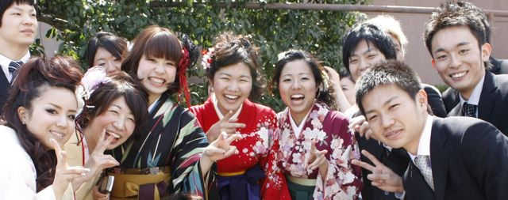
Thank you
hosack@ss.ritsumei.ac.jp

